Slide 1
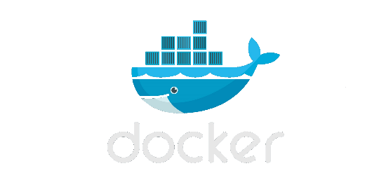

Containers Demystified
Kevin Booth

Slide 2
Containers Demystified: The why, and the what
Why do we need containers for building and shipping applications?
What are containers? This problem has been solved a myriad of different ways, what makes Docker and similar technologies different?
How do you use containers? When do you use containers?
Are you tired of the word “containers” yet? You will be.

Slide 3
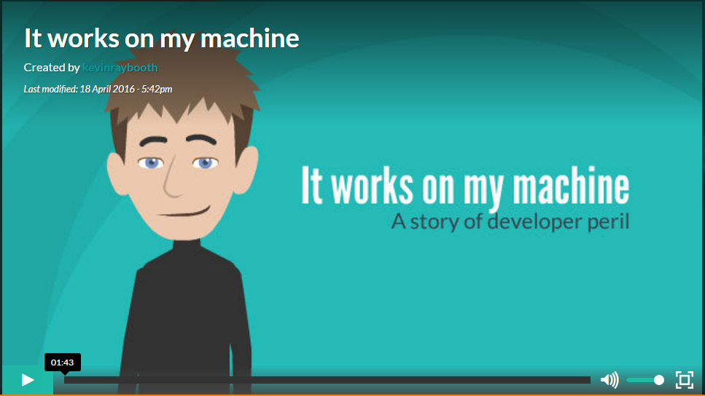
Containers Demystified: The problem

Slide 4
Containers Demystified: Container definition
A container consists of an entire runtime environment: an application, plus all its dependencies, libraries and other binaries, and configuration files needed to run it, bundled into one package. By “containerizing” the application platform and its dependencies, differences in OS distributions and underlying infrastructure are abstracted away.
By containerizing applications, you’ve taken away risk and introduced the ability to automate
Maximum physical resource utilization
The build process is repeatable using Dockerfiles

Slide 5
Containers Demystified: Container definition
Applications become Operating System + Application Code + Dependencies – A single unit
Applications can be stored in registries the same as any other application artifact
Applications can be assembled from other applications (composability)
The onus is now on the developer to make sure the application runs on the target host architecture/OS
Containers are “lightweight,” spin up in sub-second times, and use less resources than VMs

Slide 6
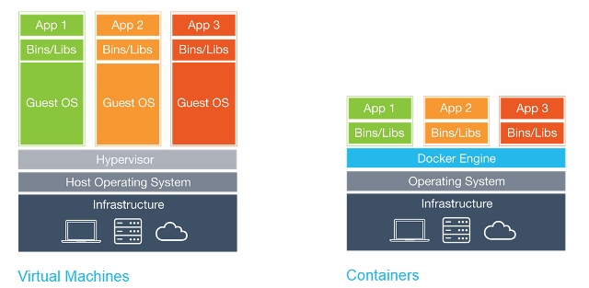
Containers Demystified: Containers vs VMs – Clear the air

Slide 7

Containers Demystified: Puzzle pieces fall in place
For something like Docker to materialize there were key pieces of infrastructure that needed to be in place.

Slide 8
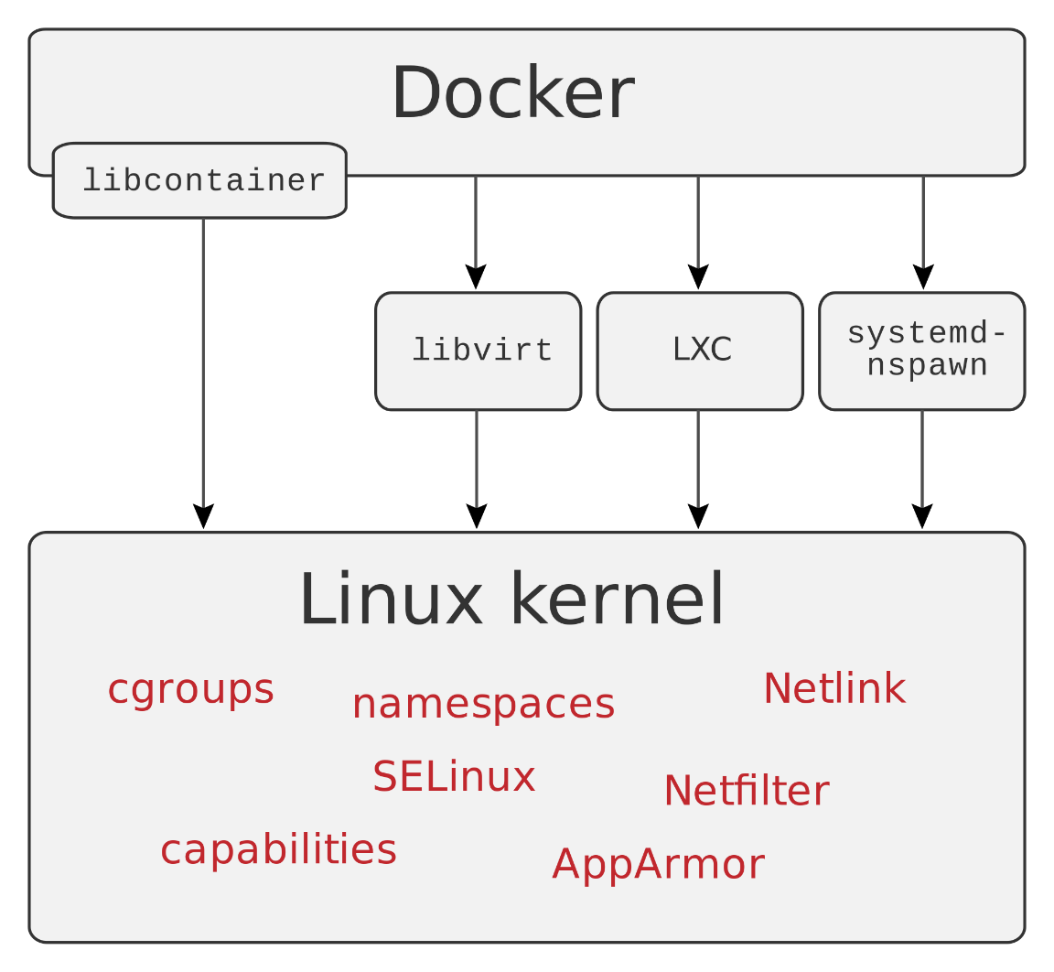
Containers Demystified: Containers and “namespaces”

Slide 9
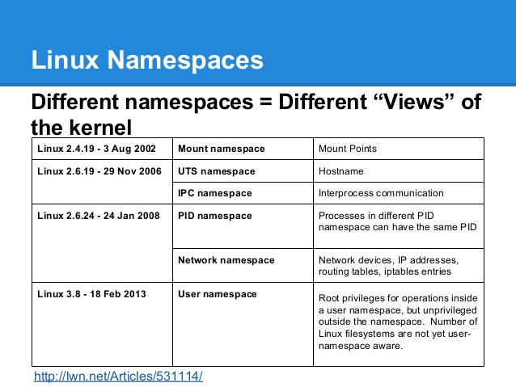
Containers Demystified: Containers and “namespaces”

Slide 10
Containers Demystified: Unified File System
Allows for the concept of “layering” file systems
Only maintains the differences between each layer
The final resultant filesystem view is the sum of the differences between each layer + the base image (think Git, but with file systems)
Application image sizes remain more manageable the VM images

Slide 11
Containers Demystified: Containers Software Defined Networking (SDN)
Allows programmatic abstraction of physical networking resources.
Allows agility compared to physical networking giving dynamic control
Being able to create new networking interfaces on the fly solved a very important piece of the Docker puzzle

Slide 12
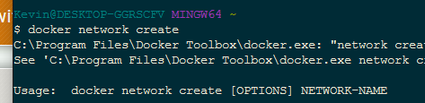
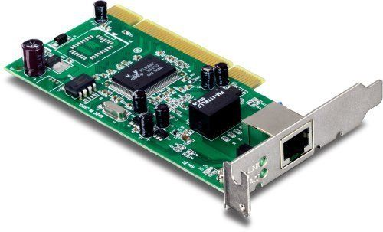
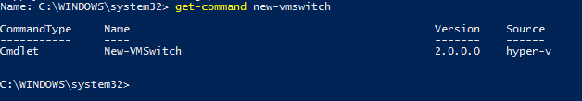
Containers Demystified: Containers Software Defined Networking (SDN)

Slide 13
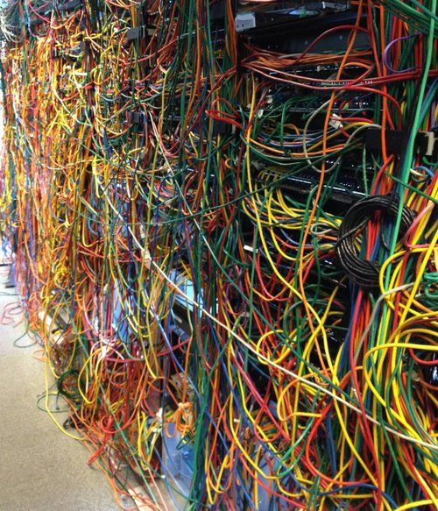
Containers Demystified: Containers Software Defined Networking (SDN)
Notes:
So no more of this mess, SDN allows you to represent this programmatically.

Slide 14
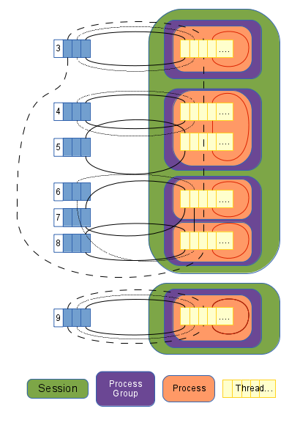
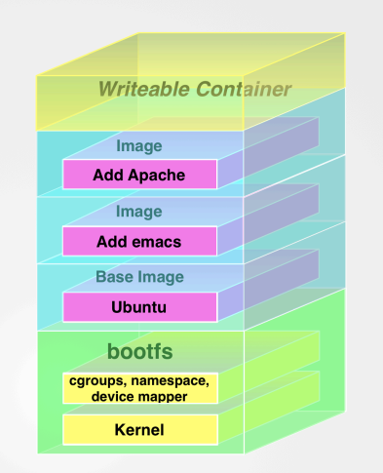
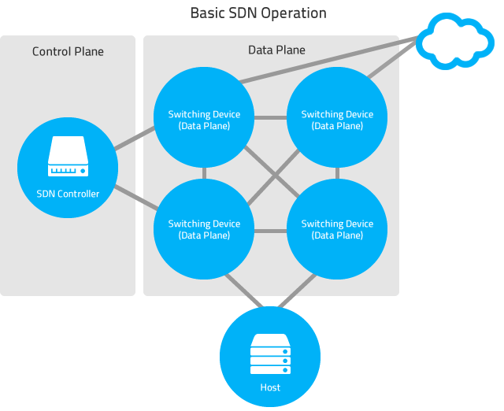
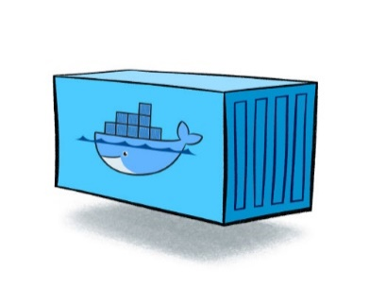
Containers Demystified: The pieces fit together
SDN
Layered File System
cgroups/namespaces
Notes:
The 3 key pieces are in place to allow Docker

Slide 15
Containers Demystified: The how
Dockerfile – breaks down all manual steps of creating an environment into a repeatable, automatable process
Examples:
Installing dependencies
Copying resources
Exposing ports
Running arbitrary commands
Naming a base (target) operating system
Just like an msbuild/grunt/gulp/maven etc file for your application+environment
What are the first things you do when you get a new machine? Or how do you configure your machine for a new project? Those steps are analogous to Dockerfile instructions

Slide 16
Containers Demystified: The how
Port mapping is very important
Docker Host
Host Port:xyz
Cotnainer1:abc

Slide 17
Containers Demystified: The how : Dockerfile commands
FROM – I need an environment based on this OS, or based on another image
ADD – Adds files from the local machine into the container
CMD – Executes a command within the container during build time
ENTRYPOINT – Allows container to be configured as executable
ENV – Adds environment variables to container
EXPOSE – Allows network ports/docker network resources to be exposed to outside
MAINTAINER – The person/persons maintaining the dockerfile
RUN – Executes arbitrary commands during build
USER – Sets the user the following commands should be executed as
VOLUME – Mounts external volumes into the container (good for servers)
WORKDIR – Sets working directory for following commands

Slide 18

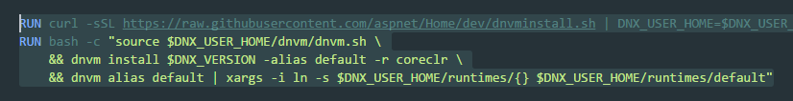


Containers Demystified: Scenario : Need to serve Asp.Net 5 pages
Well, we need a base image that can run coreclr:
Hmmm, we need the aspnet runtime:
Better make sure it’s in the path:
We’ll need a port to communicate on:

Slide 19
Containers Demystified: Scenario : Need to serve Asp.Net 5 pages : Demo
Demo Docker build

Slide 20


Containers Demystified: Scenario : Need to serve Asp.Net 5 pages : Demo
We will want to build many new containers for different .Net applications, so we will keep our base container the same
We will build our next container by referencing the first container:
Now we need an application to run:
And finally let’s build and launch the app:

Slide 21
Containers Demystified: Scenario : Need to serve Asp.Net 5 pages : Demo
Demo Docker application build

Slide 22
Containers Demystified: Scenario : Need to serve Asp.Net 5 pages : Demo
Demo Docker application build

Slide 23
Containers Demystified: Scenario : Need to serve Asp.Net 5 pages : Anoth Container
Demo Docker sql server build

